Slide 1





Upwork Design Services
Rules of Engagement
If you need some design…
Please drop your request in the #upwork-services-design Slack channel
Share your expectations along with any files, notes or drawings
Your request will be picked up by one of our Upwork designers and delivered in hours*
*Public facing documents will be checked for consistency

Slide 2



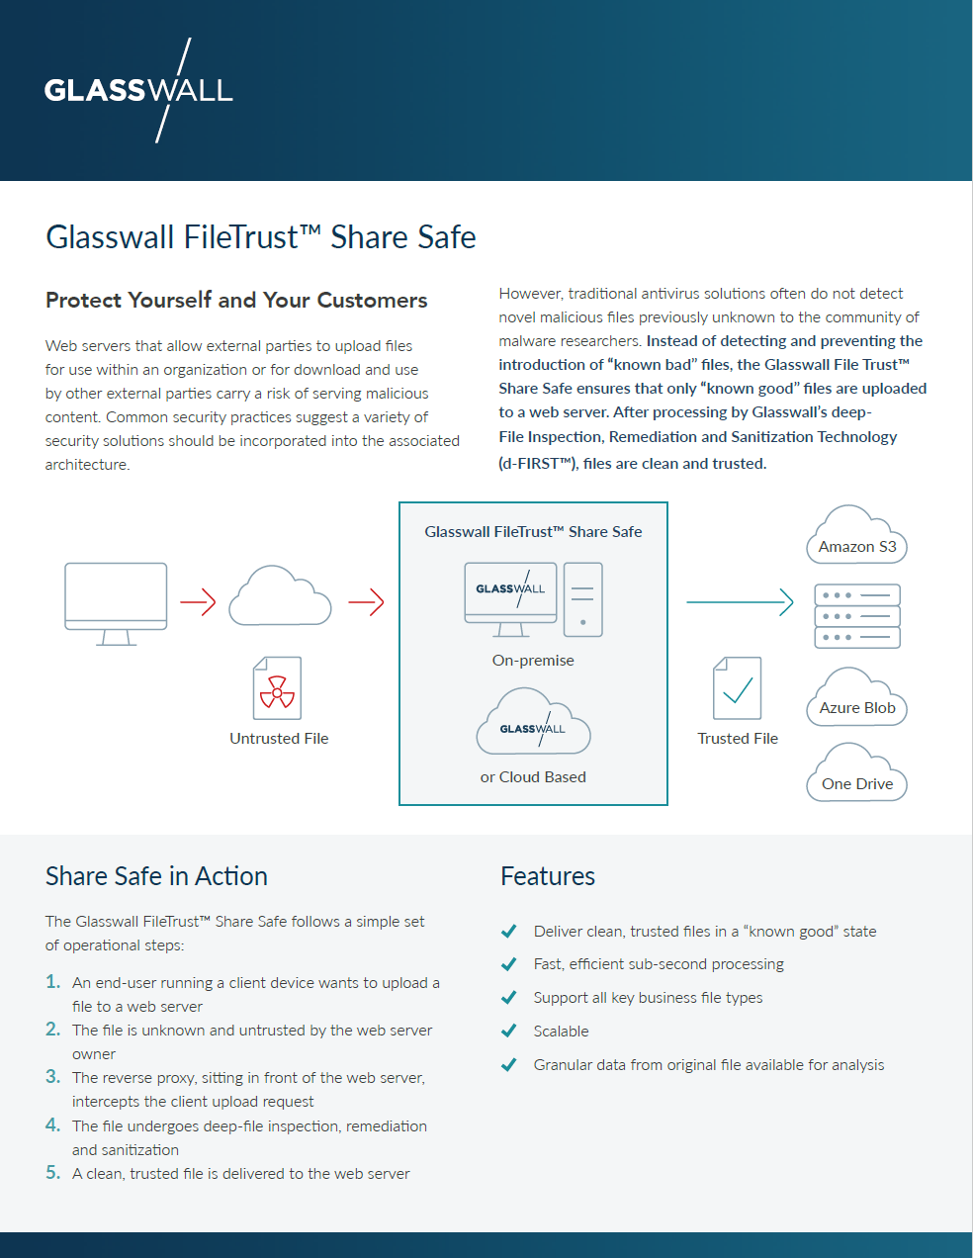
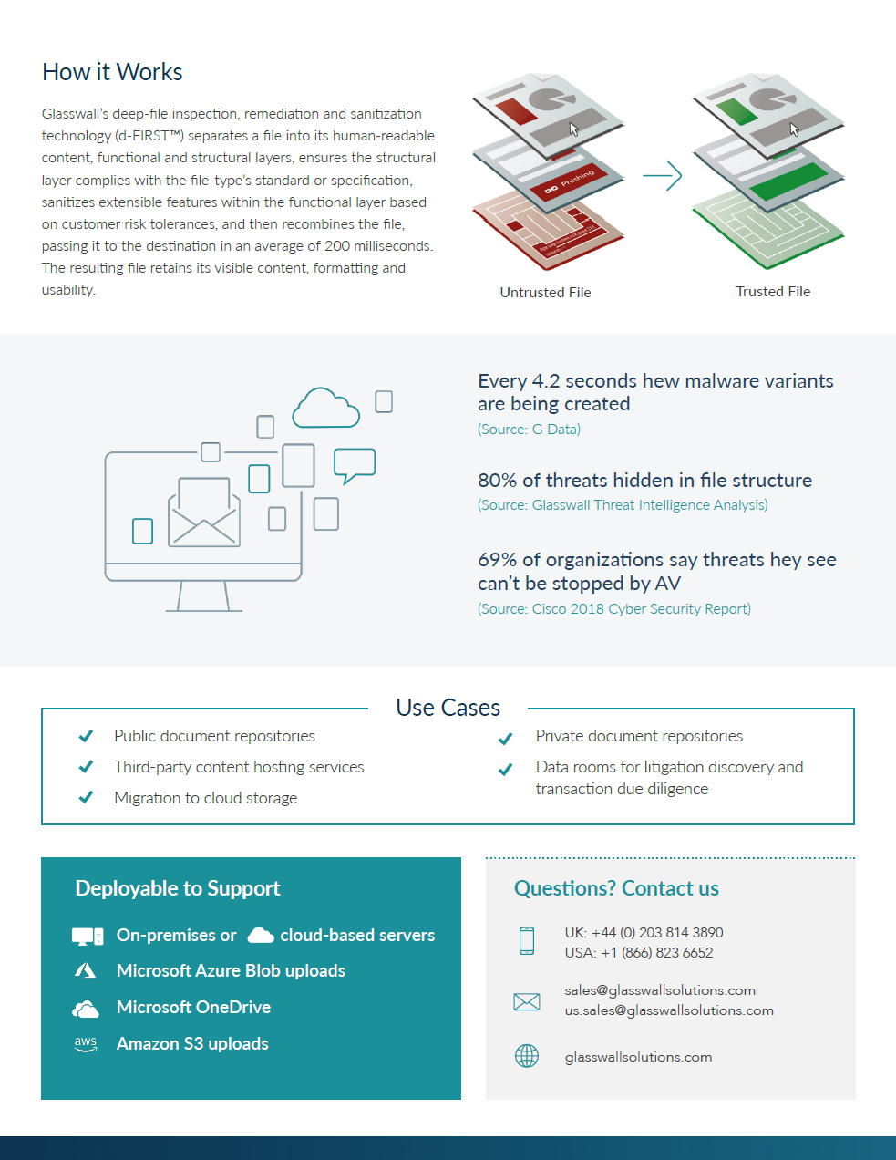
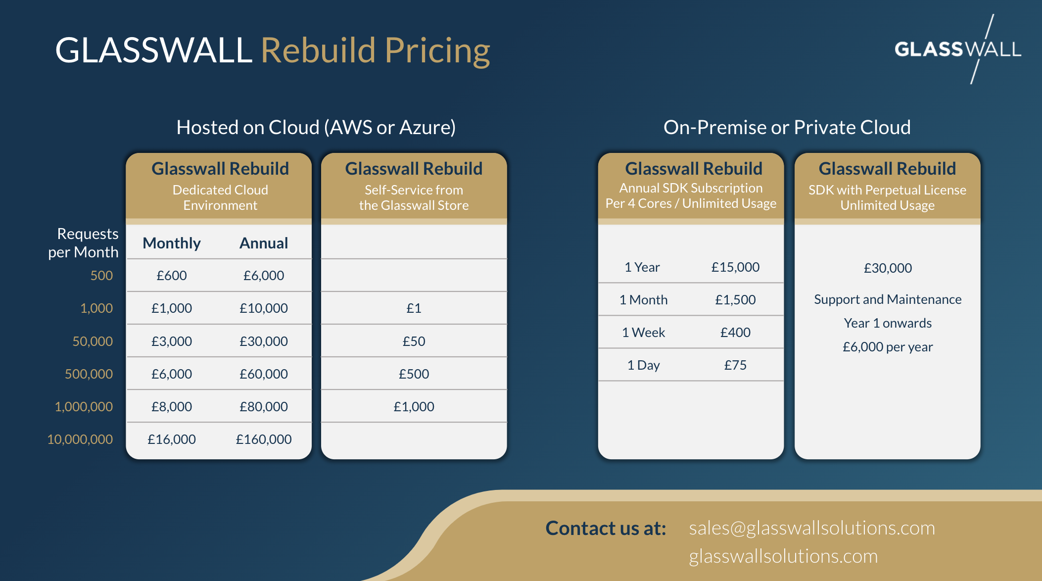
Recent Examples

